Slide 1
Basic Java
Day 3

Slide 2
Objectives
  In this lesson, you will learn to:
    Appreciate the need for object-oriented programming
    Compare OOPS with procedural programming
    Identify the advantages of object-oriented programming
    Identify the applications of object-oriented programming
    Identify classes and objects

Slide 3
Objectives
    Identify the features of object-oriented programming
      Encapsulation
      Abstraction
      Inheritance
      Polymorphism
    Need and History of Java
    Introduction to Java Programming Language

Slide 4
Need For Object Oriented Programming

Slide 5
Need for Object-Oriented Programming
  Comparing OOPS with Procedural Programming
    The commonly used programming methodologies are:
      Procedural programming
      Object-oriented programming (OOP)

Slide 6
Need for Object-Oriented Programming(Contd.)
    Procedural programming
      Involves dividing a large program into a set of sub procedures or subprograms that perform specific tasks.
      Module consists of single or multiple procedures.
      Procedures are also known as functions, routines, subroutines, or methods in various programming languages.
      In a program following procedural methodology, each step of a subprogram is linked to the previous step.

Slide 7
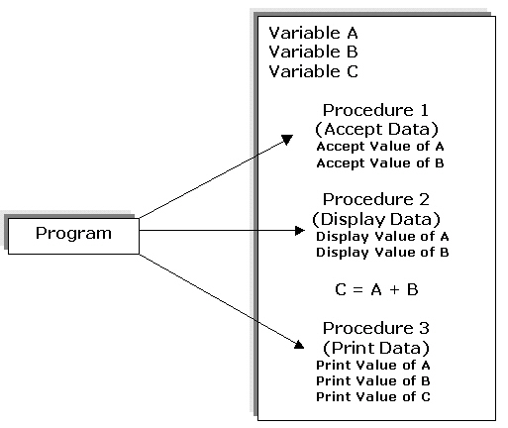
Need for Object-Oriented Programming(Contd.)

Slide 8
Need for Object-Oriented Programming(Contd.)
      Procedural programming is used for developing simple applications.
      The procedural programming methodology has various benefits over the simple sequential programming:
        Easy to read program code.
        Easy maintainable program code as various procedures can be debugged in isolation.”
        Code is more flexible as you can change a specific procedure that gets implemented across the program.

Slide 9
Need for Object-Oriented Programming(Contd.)
      The features of procedural programming methodology are:
        Large programs are divided into smaller programs.
        Most of the data is shared as global that can be accessed from anywhere within the program.

Slide 10
Need for Object-Oriented Programming(Contd.)
      Object-oriented Programming :
        A large application consists of component objects, which interact with each other.
        Can be used to develop various applications.

Slide 11
Object-Oriented Programming
  Advantages of Object-Oriented Programming:
    Real-world programming
    Reusability of code
    Modularity of code
    Resilience to change
    Information hiding

Slide 12
Object-Oriented Programming
    Real-world programming
      The object-oriented approach models the real world more accurately than the conventional, procedural approach.
    Reusability of code
      In the object-oriented approach, you build classes, which can be used by several applications.
    Modularity of code
      An object can be maintained independently of other objects.
    Resilience to change
      Object-oriented programming also enables you to evolve various versions of software.
      When a change is suggested, the old system need not be completely abandoned and re-built from scratch.
    Information hiding
      Information hiding ensures data security in a program.

Slide 13
Object-Oriented Programming(Contd.)
  Identifying the Applications of Object-Oriented Programming:
    Character User Interface (CUI) based Applications
      CUI is an interface used to interact with a computer by typing commands on the command-line.
      CUI is not user-friendly because a user needs to remember all the commands and the syntax of the commands.
    C++ for GUI applications
      Enables you to create GUI applications.
    Graphical User Interface (GUI) based Applications
      GUI is a method of interacting with a computer by directly manipulating graphical images in addition to text.
    Computer Aided Designing/Manufacturing (CAD/CAM)
      Concept of OOP is used to create graphical and numerical building blocks that can be assembled to form portable, flexible, and cost effective solutions for various real life problems.

Slide 14
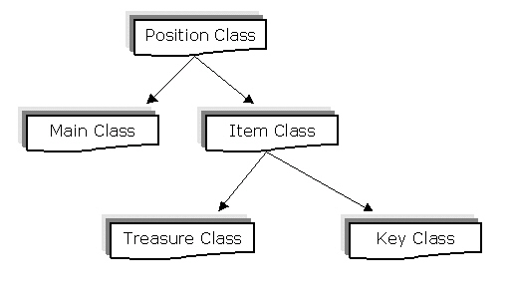
Object-Oriented Programming(Contd.)
    Games
      All the adventure games, sports games, and the space games are modeling some type of objects present in the real world.
      You can organize a game into a collection of "things,” when you apply OOP techniques to the design.

Slide 15
Features of Object Oriented Programming

Slide 16
Features of Object-Oriented Programming
  Classes and Objects
    Objects are the basic building blocks of Object Oriented Programming (OOP).
    Characteristics of Objects are:
      State
      Behavior
      Identity

Slide 17


What Are Classes and Objects?
  A class:
    Models an abstraction of objects
    Defines the attributes and behaviors of
    objects
    Is the blueprint that defines an object
  An object:
    Is stamped out of the class mold
    Is a single instance of a class
    Retains the structure and behavior
    of a class
Notes:
What Is an Object?
An object is something tangible, something that can be seen or touched, or something that can be alluded to and thought about.
Object-oriented programs consist of several objects. These objects communicate with each other by sending messages from one object to another. In a true object-oriented program, that is all you have: a coherent group of communicating objects. New objects are created when needed, old ones are deleted, and existing objects carry out operations by sending messages.
Some examples of objects in an OO program are Customer, Invoice, RentalAgreement, Video, and so on. Each of these objects holds information about itself and performs certain behaviors. A customer has a name, address, and phone number. A customer may also rent a video, return a video, pay a bill, and have other behaviors.
What Are Classes?
A class is a model of abstraction from real-world objects. A class defines the properties and behavior of a set of objects. A class denotes a category of objects and acts as a blueprint for creating that type of object.

Slide 18




An Object’s Attributes Maintain Its State
  Objects have knowledge about their current state.
  Each piece of knowledge is called an attribute.
    The values of attributes dictate the objects’ state.
Object: My blue pen
Attribute: Ink amount
Object: Acme Bank ATM
Attribute: Cash available
Notes:
An Object’s Attributes Maintain Its State
All the data that an OO system requires must be located in attributes of the existing objects. Some objects have little or no data, whereas other objects have a lot of data; it depends entirely on the operations that the object is to perform.
The collection attributes that are defined in an object determine its internal structure; in essence, the object is a composite data structure, which is often called a user-defined type.
The values that are held in the attributes, at a given point in time, represent the current state of the object. As the values of attributes change, over time, the state of the object changes. The state of an object is remembered as long as the object exists in the system (memory). The attribute values are typically altered by executing an object method in response to some internal or external event. It is the job of the object code to maintain the integrity of the object’s state; that is, to ensure that the object state is valid for that object.

Slide 19
What Is a Class?
  A class is a template for objects.
  A class definition specifies the operations and attributes for all instances of that class.
  A class is used to manage complexity.
When you create my blue pen, you do not have to specify its operations or attributes. You simply say what class it belongs to.
Notes:
A Class Is a Template for All Objects of That Type
In an object-oriented application, a class is a specification of all the operations and attributes for that type of object. When you create a particular object (or instance) of that class, you must initialize the attributes and links with specific values. This can be done either when you create the object or at a later stage by carrying out some operation on the object.
If you view a class definition as a cookie-cutter, then each class creates cookies (objects) of the same shape (set of operations, attributes, and links).
Examples of Classes and Objects
To describe the characteristics of all pens, you may define a pen class and specify operations, such as write and refill, and attributes, such as ink color and ink remaining. You can then create individual pen objects to represent my blue pen, teacher’s red pen, and so on.
When you create a pen object, you may initialize the ink amount to be full (or empty) and specify the color of the ink. The write operation for the pen would presumably check the value of ink amount and refuse to write if the pen was empty.
Classes Are a Natural Way of Describing Similar Objects
The concept of classes is something that you use every day, without realizing it. For example, when you sat down in this classroom, presumably you sat on a chair. You probably did not care which particular chair object you used, as long as the object exhibited all the structure and behavior of an object belonging to the chair class. The use of chair objects comes naturally to you after you have grasped the concept of chair, because all chairs exhibit the same properties although they may each have differing attributes.

Slide 20
How Do You Identify a Class?
  Identify the common behavior and structure for a group of objects.
  Recognize a single coherent concept.
  Caution: A common misconception is the use of the words classes and objects interchangeably. Classes define objects.
My blue pen ops: write, refill
attribs: ink amount, color of ink
Your blue pen ops: write, refill
attribs: ink amount
Notes:
How Do You Classify Objects?
The dictionary defines a class as “a set, collection, group, or configuration containing members having or thought to have at least one attribute in common.”
Most objects in the real world do not have names; you usually identify them by the class that they belong to. For example, the large woody leafy thing at the bottom of your garden is usually referred to as a tree. The object is the thing at the bottom of your garden, but the class it belongs to is tree.
Object-oriented software development is all about identifying classes and defining what you mean by them; that is, “Which of all its possible operations, attributes, and links are you interested in for our system?”
It is not always as easy as spotting the trees from the woods; sometimes you get many objects that do not seem to have much in common, and you have to work at identifying the similarities between the objects.
Classification Is Not Just a Computer Science Concept
Classification is not a new computer science technique; classification has been going on since the time of Plato. Most of the objects in the real world are referred to by using a classification system, and you often use different classifications for the same objects depending on your current viewpoint.

Slide 21
Comparing Classes and Objects
  Classes are static definitions that you can use to understand all the objects of that class.
  Objects are the dynamic entities that exist in the real world and your simulation of it.
  Caution: OO people almost always use the words classes and objects interchangeably; you must understand the context to differentiate between the two meanings.
Notes:
Comparing Classes and Objects
Objects exist only at run time; they hold attribute values, provide operations to be executed, and communicate by sending messages to each other. There can be many instances of a particular type of object.
Classes are loaded into the run-time environment and used as a template to create the object instances, similar to a cookie-cutter. Although they are static definitions, they must be available at run time to be able to manufacture objects with all the qualities (for example, structure and function) defined in the class.
A loose analogy from a purely structural perspective: A database table is a definition of a row; that is, the table structure can be loosely thought of as a class definition, and each row holds specific values as a separate instance with a structure that is defined by the table (the class). Both the table definition and its rows must exist in the database. There are many rows, but only one table definition.

Slide 22

Features of Object-Oriented Programming
  Encapsulation
    Grady Booch, defined the encapsulation feature as:
    “Encapsulation is the process of hiding all of the details of an object that do not contribute to its essential characteristics.”
    Encapsulation is the feature that provides security to the data as well as the methods of a class.

Slide 23
Features of Object-Oriented Programming(Contd.)
  Abstraction
    Grady Booch defined the encapsulation feature as:
    “An Abstraction denotes the essential characteristics of an object that distinguishes it from all other kinds of objects and thus provides crisply defined conceptual boundaries, relative to the perspective of the viewer.”
    Abstraction refers to the attributes of an object that clearly demarcates it from other objects.
    The concept of abstraction is implemented in object-oriented programming by creating classes.
  Encapsulation hides the irrelevant details of an object and abstraction makes only the relevant details of an object visible.

Slide 24
Features of Object-Oriented Programming(Contd.)
  Inheritance:
    Enables you to extend the functionality of an existing class.
    Enables you to add new features and functionality to an existing class without modifying the existing class.
    Enables you to share data and methods among multiple classes.

Slide 25
Features of Object-Oriented Programming(Contd.)
    Superclass and Subclass
      A superclass or parent class is the one from which another class inherits attributes and behavior.
      A subclass or child class is a class that inherits attributes and behavior from a superclass.

Slide 26
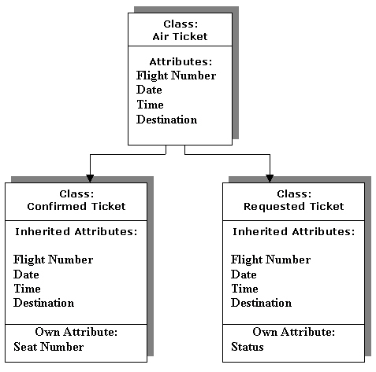
Features of Object-Oriented Programming(Contd.)

Slide 27
Features of Object-Oriented Programming(Contd.)
    Relationships Between Classes
      Kind-of
      Is-a
      Part-of
      Has-a

Slide 28
Features of Object-Oriented Programming(Contd.)
      Kind-of
        A subclass always inherits the attributes of the superclass.
Ticket
Confirmed
Ticket
Kind-of

Slide 29
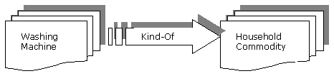
Features of Object-Oriented Programming(Contd.)
      Kind-of (Contd.)
        Washing machine is a kind of household commodity and depicts the kind-of relationship.

Slide 30
Features of Object-Oriented Programming(Contd.)
      Is-a Relationship
        Relationship between objects of superclass and subclass is referred to as an is-a relationship.
Confirmed
Ticket
Ticket
Ticket for
New York
Is-A
Kind of
Is-A

Slide 31
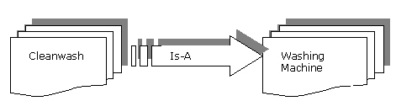
Features of Object-Oriented Programming(Contd.)
      Is-a Relationship (Contd.)
        The is-a relationship between the Cleanwash class and Washing Machine class.

Slide 32
Features of Object-Oriented Programming(Contd.)
      Part-of Relationship
        When a class is an element of another class, it depicts the part-of relationship.
Address
Student
Part of

Slide 33
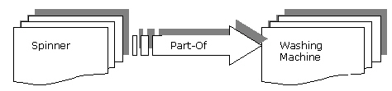
Features of Object-Oriented Programming(Contd.)
      Part-of Relationship (Contd.)
        A spinner being a part of washing machine depicts the part-of relationship between the spinner and the washing machine class.

Slide 34
Features of Object-Oriented Programming(Contd.)
      Has-a Relationship
        Is reverse of the part-of relationship.
        The has-a relationship is also known as aggregation or composition.
Student
Detail
Has-a
Address

Slide 35
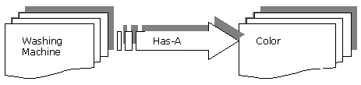
Features of Object-Oriented Programming(Contd.)
      Has-a Relationship (Contd.)
        A washing machine has a spinner and depicts the has-a relationship between the Washing Machine and Color class.

Slide 36
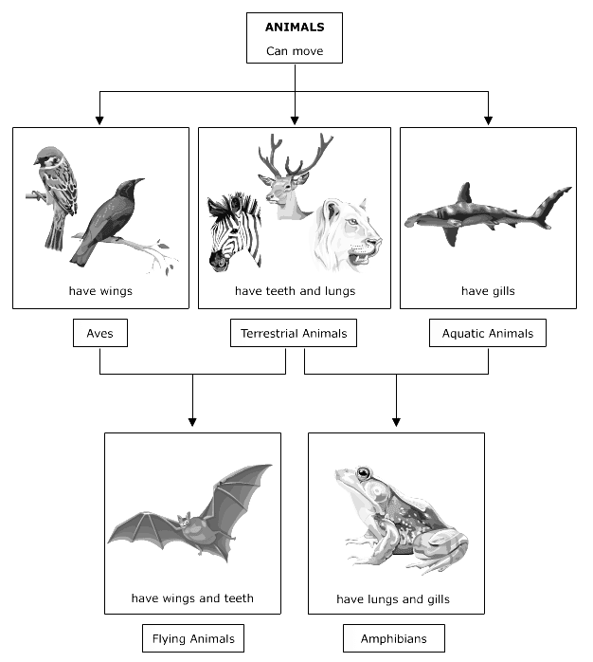
Features of Object-Oriented Programming(Contd.)
      Types of Inheritance

Slide 37
Features of Object-Oriented Programming(Contd.)
      Types of Inheritance (Contd.)
        Single inheritance
        Multiple inheritance

Slide 38
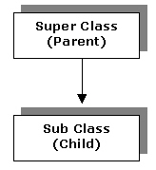
Features of Object-Oriented Programming(Contd.)
      Types of Inheritance(Contd.)
        Single inheritance
        Subclass is derived from only one superclass.

Slide 39
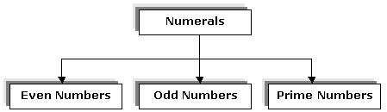
Features of Object-Oriented Programming(Contd.)
      Types of Inheritance (Contd.)
        Single inheritance

Slide 40
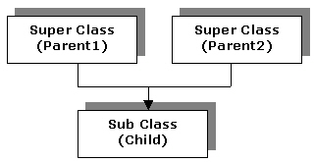
Features of Object-Oriented Programming(Contd.)
      Types of Inheritance(Contd.)
        Multiple inheritance
        A subclass is derived from more than one super class.

Slide 41
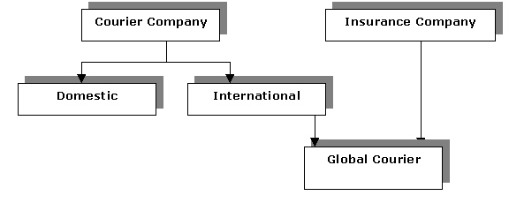
Features of Object-Oriented Programming(Contd.)
      Types of Inheritance (Contd.)
        Multiple inheritance

Slide 42
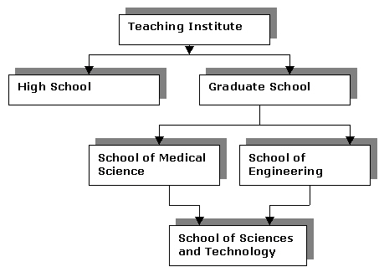
Features of Object-Oriented Programming(Contd.)
      Types of Inheritance (Contd.)
        Multiple inheritance
Single
Inheritance
Multiple
Inheritance

Slide 43
Features of Object-Oriented Programming(Contd.)
  Polymorphism
    Derived from two Latin words-Poly, which means many, and morph, which means forms.

Slide 44
Evolution and Need for Java

Slide 45
Evolution and Need for Java
You can use Java to develop network-oriented programs because networking features are inbuilt in Java.
In 1991, a team of software developers at Sun Microsystems, USA, was designing a language for consumer electronic devices.
The development team headed by James Gosling wanted to design a portable language using which programs should be developed such that they can run on computers with different platform.
The team considered C++ as the model language for designing Java language. The team deprecated various ambiguous features from this new language.
Initially, this developed language was called Oak, but was later renamed to Java.

Slide 46
Evolution and Need for Java (Contd.)
  The following table lists the various developments that took place in the evolution of Java:
Year
Development
1990
Sun Microsystems developed software to manipulate electronic devices.
1991
A new language named Oak was introduced using the most popular object-oriented language C++

Slide 47
Evolution and Need for Java (Contd.)
Year
Development
1993
The WWW appeared on the Internet that transformed the text-based Internet into graphical Internet.
1994
Sun Microsystems team developed a Web browser called HotJava to locate and run applet programs on the Internet.
1995
Oak was renamed as Java.
1996
Java was established as an
Object-oriented programming language.

Slide 48
Java Programming Language
  Need for Java
    Java applications are:
      Character User Interface (CUI) Applications:Has access to the system resources, such as file systems and can read and write to files on local computers.
      Graphical User Interface (GUI) Applications: Used in the Windows environment.
      Applets: Are small executable programs that run on a Web page and require a Java-enabled browser, such as Internet Explorer or Netscape Navigator.
      Servlets:Are the programs that are used to extend the functionality of Web servers.
      Packages:Are collection of classes that can be reused by applications and applets.

Slide 49
Java Programming Language
  Need for Java
    Java applications are:
      Character User Interface (CUI) Applications:Has access to the system resources, such as file systems and can read and write to files on local computers.
      Graphical User Interface (GUI) Applications: Used in the Windows environment.
      Applets: Are small executable programs that run on a Web page and require a Java-enabled browser, such as Internet Explorer or Netscape Navigator.
      Servlets:Are the programs that are used to extend the functionality of Web servers.
      Packages:Are collection of classes that can be reused by applications and applets.

Slide 50
Java Programming Language (Contd.)
  Characteristics of Java
    Simple
    Object-oriented
    Compiled and interpreted
    Portable
    Distributed
    Secure

Slide 51
Java Programming Language (Contd.)
  Java Architecture
    Various components of Java Architecture are:
      Java programming language
      Java class file
      Java Virtual Machine (JVM)
      Java Application Programming Interface (API)

Slide 52

Java Programming Language (Contd.)
  Java Programming Language and class File
    The Java programming environment

Slide 53
Java Programming Language (Contd.)
  Java Virtual Machine (JVM)
    Components of the JVM:
      Class loader
      Execution engine
      Just In Time(JIT) compiler

Slide 54
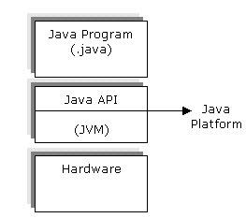
Java Programming Language (Contd.)
  Java Application Programming Interface (API)
    Components of Java platform

Slide 55
Java Programming Language (Contd.)
  Java architecture security features:
    Compiler level security
    Byte code verifier
    Class loader
    Sandbox model

Slide 56
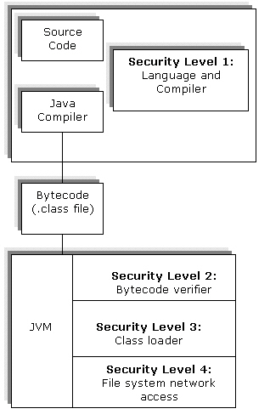
Java Programming Language (Contd.)
  Security levels in Java architecture:

Slide 57
Java Programming Language (Contd.)
  Bytecode is verified in two phases:
    In the first phase, the verifier checks for the structure of the .class file.
    The second level phase occurs when the Bytecode is run.The Bytecode verifier checks the validity of classes, variables, and methods used in a program.

Slide 58
Java Programming Language (Contd.)
  Java architecture security features:
    Compiler level security
    Byte code verifier
    Class loader
    Sandbox model

Slide 59
Java Programming Language (Contd.)
  Security levels in Java architecture:

Slide 60
Java Programming Language (Contd.)
  Bytecode is verified in two phases:
    In the first phase, the verifier checks for the structure of the .class file.
    The second level phase occurs when the Bytecode is run.The Bytecode verifier checks the validity of classes, variables, and methods used in a program.

Slide 61
Compiling and Running a Java Application
  To compile a .java file:
  To execute a .class file:
  Remember that case matters.
prompt> javac SayHello.java
… compiler output …
prompt> java SayHello
Hello world
prompt>
Notes:
Java Development Kit (JDK) Tools
J2SE includes javac.exe and java.exe, two executables for compiling and executing a Java program.
Compiling Java Code
Run javac.exe from the command prompt to compile .java files into .class files. For example, to compile SayHello.java into a bytecodes file named SayHello.class, enter the following at the command prompt:
javac SayHello.java
Running a Java Application from the Command Line
The java.exe executable loads the class, verifies the bytecodes, interprets it into machine language, and executes the code. Start the interpreter by entering the following command at the command prompt:
java SayHello
This starts JVM, which loads SayHello.class and tries to call its main() method. JVM expects the SayHello.class to have a main() method, where the program execution will start. If SayHello.class calls methods in other classes, then JVM loads these other classes only when they are required.

Slide 62
The CLASSPATH Variable
  Is defined in the operating system
  Directs the JVM and Java applications where to find .class files
  References built-in libraries or user-defined libraries
  Enables interpreter to search paths, and loads built-in classes before user-defined classes
  Can be used with “javac” and “java” commands
Notes:
Setting the CLASSPATH
If the CLASSPATH variable is not set, then a default is used. The default includes the absolute path to the jdk1.4.2_03\bin,… \lib\, and …\classes\ directories, which house the J2SE packages (contained in the rt.jar file). You can create a …/classes/ directory, add your class files, and CLASSPATH will find them.
CLASSPATH examines individual class files, or those stored in .zip or .jar files. Set the CLASSPATH variable by using the commands: setenv in UNIX (in a C-Shell), and set in Windows. Separate directories with a semicolon “;” (for example, c:\myClasses;d:\myOtherClasses). Set CLASSPATH to include the directory containing the .class files.
The interpreter looks for classes in the directory sequence as they are found in the CLASSPATH variable. If the interpreter cannot find the named class in the first directory, then it searches the second and all the others in the list.
If you want the CLASSPATH to point to class files that belong to a package, then you must specify a path name that includes the path to the directory one level above the directory that has the name of your package.
You can override the CLASSPATH setting in the javac and java commands, by using the “–classpath” option.

Slide 63
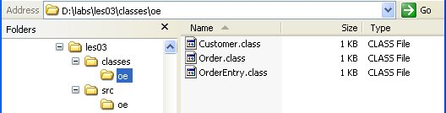
CLASSPATH: Example
Location of .class files in the oe package
Setting CLASSPATH
C:\>set CLASSPATH=D:labs\les03\classes\oe

Slide 64
Contents of a Java Source
  A Java source file can contain three top-level constructs:
    Only one package keyword followed by the package name, per file
    Zero or more import statements followed by fully qualified class names or “*” qualified by a package name
    One or more class or interface definitions followed by a name and block
  File name must have the same name as the public class or public interface.
Notes:
RentalItem.java
package practice16; // collection of classes of similar functionality
import java.util.*; // import for Date class
public class RentalItem {
private InventoryItem inventoryItem;
private String dueDate;
private Date dateReturned;
public RentalItem(int aInventoryItemId) {
try {
inventoryItem = DataMan.fetchInventoryItemById(aInventoryItemId);
}
catch (ItemNotFound e2) {
System.out.println("Invalid Item ID");
}
dueDate = calcDueDate();
} // end constructor

Slide 65
Establishing Naming Conventions
Naming conventions include:
  Class names
    Customer, RentalItem, InventoryItem
  File names
    Customer.java, RentalItem.java
  Method names
    getCustomerName(), setRentalItemPrice()
  Package names
    oracle.xml., java.awt, java.io
Notes:
Naming Conventions
File Names
Java source code is stored in files with the .java extension. Use the name of the class held within the file as the file name. Remember that Java is case sensitive, and the names must match exactly, including case. Compiled Java code, or bytecodes, is stored in files with the .class extension.
The name of the Java source file must be the name of the public class in the file; otherwise, the code will not compile. You may have source code for more than one class in the file, but only one can be public, and the file name must be the same name as the public class.
Class Names
Use descriptive nouns or noun phrases for class names. Capitalize the first letter of each word in the class name, including the first word (for example, MyFirstClassName).

Slide 66
Defining a Class
Class definitions typically include:
  Access modifier
  Class keyword
  Instance fields
  Constructors
  Instance methods
  Class fields
  Class methods
Notes:
Class Definition
A class is an encapsulated collection of data and methods to operate on the data. A class definition, data and methods, serves as a blueprint that is used in the creation of new objects of that class.
A class definition typically consists of:
Access modifier: Specifies the availability of the class from other classes
Class keyword: Indicates to Java that the following code block defines a class
Instance fields: Contain variables and constants that are used by objects of the class
Constructors: Are methods having the same name as the class, which are used to control the initial state of any class object that is created
Instance methods: Define the functions that can act upon data in this class
Class fields: Contain variables and constants that belong to the class and are shared by all objects of that class
Class methods: Are methods that are used to control the values of class fields
The order of the fields, constructors, and methods does not matter in Java. Ordering the parts of a Java program consistently will, however, make your code easier to use, debug, and share. The order listed in the slide is generally accepted.

Slide 67
Rental Class: Example
Access modifier
public class Rental {
//Class variable
static int lateFee;
// Instance variables
int rentalId;
String rentalDate;
float rentalAmountDue;
…
// Instance methods
float getAmountDue (int rentId) {
…
}
…
}
Declaration
Instance variable
Instance method
Notes:
Rental Class: Example
This slide shows the syntax of a class definition. Every Java program needs at least one class definition, even if the class contains only a static main() method.
The First Line
The class definition usually starts with the public access modifier. If you omit the public modifier, then the class is visible only to other classes within the same package. The access modifier is followed by the class keyword, followed by the class body enclosed in braces.
Instance Variables
The class body contains declarations of instance variables and instance methods. Instance variables constitute the state of an object. Instance variables are usually declared private; if no access level is specified, then they can be accessed by any class in the same package. The access modifier is followed by the class keyword, followed by the class name then the class body enclosed in braces.

Slide 68
Creating Code Blocks
  Enclose all class declarations.
  Enclose all method declarations.
  Group other related code segments.
public class SayHello {
public static void main(String[] args) {
System.out.println("Hello world");
}
}
Notes:
Code Blocks
Enclose class declarations within braces { }. The class declaration contains variables, constants, and methods. The class body must begin on a new line following the class declaration and the opening brace. Indicate the end of the class declaration by a single closing brace on a new line. There is another coding convention, which puts the opening brace on the next line even with the closing brace from the previous statement.
Method declarations follow the same form with the opening brace on the same line as the method definition and the closing brace on a new line. All statements and declarations within the braces are part of the method.
You can also group code segments within a method declaration by using braces. Grouping enhances the readability of your code. The easier it is to read and follow your code, the easier it will be to debug and reuse.
Variables that are defined within a code block are available during the execution of that code block and are discarded at the completion of execution.
main() Method
The interpreter looks for a specific method to start the program, and that method is called main(). It is simply the starting place for the interpreter to begin. Only one class will need to have a main method to get things started. You only need a main method for an application. If you are writing an applet, then the main method is not needed, because the browser has its own way to start or bootstrap the program.

Slide 69


Defining Java Methods
  Always define within a class.
  Specify:
    Access modifier
    Static keyword
    Arguments
    Return type
[access-modifiers] [static] "return-type"
"method-name" ([arguments]) {
"java code block“ … }
return
Notes:
Method Definition
When you define a class for an object-oriented program, you implement all the behavior of that class in one or more methods. A Java method is equivalent to a function, procedure, or subroutine in other languages, except that it must be defined within a class definition. Methods consist of the following:
Access modifier: You can specify a method as either public, private, or protected. Public methods can be known and used by external users, whereas private methods can be seen or used only by methods within the class. Protected methods are accessible from any class that extends or inherits from the class.
Static keyword: Variables and methods are usually accessed for a particular object. If the method or variable is defined with the static keyword, then it becomes a class method or variable, which means that it applies to the class of objects as a whole and not as individual objects. Static variables are shared by all objects of that class.
Arguments: The arguments that are listed for a method are those parameters that are required for the method to perform its function.
Return type: A return type is required for all method definitions. There is no default return type in Java. The return type specifies the object type that will be returned when the method has completed its task. It can be an integer, a string, any defined object type, or void.

Slide 70
Examples of a Method
public float getAmountDue (String cust){
// method variables
int numberOfDays;
float due;
float lateFee = 1.50F;
String customerName;
// method body
numberOfDays = getOverDueDays();
due = numberOfDays * lateFee;
customerName = getCustomerName(cust);
return due;
}
Declaration
Method
variables
Method
statements
Return
Notes:
Method Example
Declaration
In this example, the defined method returns a float primitive type. The method name is declared as getAmountDue. The method name begins with a lowercase letter with the beginning letter of each subsequent word in uppercase letters. The next item is the declaration of the expected parameter list. The parameter list consists of the argument data type and argument name.
Method Variables
The next set of statements defines any method-specific variables. These variables are used only during the execution of the method and are discarded when control is passed back to the object that called this method. The float data type is used for real numbers (numbers with decimal points).
Method Statements
The executable body of the method comes next. This section contains the Java statements that are used to act upon data. It can include conditional statements, data manipulation operations, or any other valid Java statements.
Return
The return statement accomplishes two things. The return causes the execution to branch back to the caller of the method, and then it passes back the specified value, if there is one.

Slide 71
Declaring Variables
  You can declare variables anywhere in a class block, and outside any method.
  You must declare variables before they are used inside a method.
  It is typical to declare variables at the beginning of a class block.
  The scope or visibility of variables is determined in the code block.
  You must initialize method variables before using them.
  Class and instance variables are automatically initialized.
Notes:
Declaring Variables
Declaration
Java requires that variables be declared before they can be accessed. Declare variables and constants by placing each statement on a separate line, so that the code is clear and easy to understand. You can declare multiple variables of the same type within one statement.
Scope
If variables or constants are required only within a code block, then declare them at the top of the code block. Variables that are defined within a code block will be discarded when the execution of the code block is complete. This is useful for temporary variables or those needed to hold specific information during a calculation or process. After the process is complete, they are no longer needed.
Initialization
Whenever possible, initialize variables at declaration. This provides some insight into the use or purpose of the variable. The only reason for not initializing at declaration is if the value is dependent on a calculation that is not yet performed.
When you declare primitive instances or class variables, they are automatically initialized to a default value depending on their type.

Slide 72



Rules for Creating Statements
  Use a semicolon to terminate statements.
  Define multiple statements within braces.
  Use braces for control statements.
Notes:
Statements
Java statements cause some action to occur, such as setting a value, sending output, reading a database, and so on. They always end with a semicolon. Compound statements are a list of related statements that are contained within a set of braces. Indent the statements one level below the enclosing statement for clarity. Place the opening brace on the line that begins the compound statement. Place the closing brace on a separate line, indented to the correct level. Use braces around all statements when they are part of a control (if-else) structure.
public float getAmountDue (String cust) {
float due = 0;
int numberOfDays = 0;
float lateFee = 1.50F;
If (…) { {int tempCount = 1; // new code block
due = numberOfDays * lateFee;
tempCount++; //nested compound statement
… }
// end code block
} //end if
return due;
}

Slide 73
Command-line Arguments
A Java application can accept any number of arguments from the command-line.
Command-line arguments allow the ser to affect the operation of an application.
The user enters command-line arguments when invoking the application and specifies them after the name of the class to r n.

Slide 74
Command-line Arguments
For example, suppose you have a Java application, called Sort, that sorts five numbers, you run it like this:
Note: The arguments are separated by spaces.

Slide 75
How Java Application Receive
Command-line Arguments
In Java, when you invoke an application, the runtime system passes the command-line arguments to the application's main method via an array of Strings.
  public static void main( String[] args )
Each String in the array contains one of the command-line arguments.

Slide 76
args [ ]array
Given the previous example where we run:
java Sort 5 4 3 2 1
the arguments are stored in the args array of the main method declaration.

Slide 77
Example
To print the array of arguments,we write:
public class CommandLineSample
{
public static void main( String[] args )
{
for(int i=0; i<args.length; i++)
{
System.out.println( args[i] );
}
}
}

Slide 78
Reserved Keywords
boolean
byte
char
double
float
int
long
short
void
abstract
final
native
private
protected
public
static
synchronized
transient
volatile
strictfp
break
case
catch
continue
default
do
else
finally
for
if
return
switch
throw
try
while
class
extends
implements
interface
throws
import
package
instanceof
new
super
this
true false
null
Notes:
Reserved Keywords in Java
All the words in this slide are keywords in the Java language. These reserved words must not be used as variable names. There are 51 reserved words in Java2.
Additional Reserved Keywords
In addition to the keywords listed in the slide, const and goto are reserved and cannot be used as identifiers.
Instructor Note
Do not go through the list of keywords. Briefly describe the category of keywords in each box. Also make students aware of the reserved keywords in the notes.
Also, technically speaking, true, false, and null are literals, not keywords as such. Java2 has a new reserved keyword, strictfp. Null is not a Boolean type as in PL/SQL.
strictfp is used to allow for “double” variables to perform calculations, where the result is larger than Double.MAX_VALUE. strictfp is equivalent to FP-strict, which allows for a double expression to be evaluated as positive infinity (which the program prints as “Infinity”).

Slide 79
Variable Types
  Eight primitive data types:
    Six numeric types
    A character type
    A Boolean type (for truth values)
  User-defined types:
    Classes
    Interfaces
    Arrays
a
b
c
Notes:
Variable Types
Variables are the basic storage unit in Java. A variable is a symbolic name for a chunk of memory. Variables can be defined to hold primitive values (which are not real objects in Java) or to hold object references. The object references that they hold can be user-defined classes or Java-defined classes.
Primitive Data Types
A variable declaration consists of a type and a name. Consider the following example:
double balanceDue;
This statement declares a variable called balanceDue, whose type is double. double is one of the eight primitive data types that are provided in the Java language. These types are called primitive because they are not objects and they are built into the Java language.
Unlike similar types in other languages, such as C and C++, the size and characteristics of each primitive data type are defined by the Java language and are consistent across all platforms.

Slide 80
Primitive Data Types
Floating
True
Integer
Character
Point
False
byte
short
float
char
boolean
int
double
long
1, 2, 3, 42
3.0F
'a' '\141'
true
07
.3337F
'\u0061'
false
false
0xff
0
4.022E23
0.0f
'\n'
‘\u0000’
Append uppercase or lowercase “L” or “F” to the number to specify a long or a float number.
Notes:
Primitive Data Types
Integer
Java provides four different integer types to accommodate different size numbers. All the numeric types are signed, which means that they can hold positive or negative numbers.
The integer types have the following ranges:
byte range is –128 to +127. Number of bits = 8.
short range is –32,768 to +32,767. Number of bits = 16.
int range is –2,147,483,648 to +2,147,483,647; int is the most common integer type. Number of bits = 32.
long range is –9,223,372,036,854,775,808 to +9,223,372,036,854,775,807. Number of bits = 64.
Floating Point
The floating-point types hold numbers with a fractional part and conform to the IEEE 754 standard. There are two types: float and double. double is so called because it provides double the precision of float. float uses 32 bits to store data, whereas double uses 64 bits.

Slide 81
What Are Variables?
  A variable is a basic unit of storage.
  Variables must be explicitly declared.
  Each variable has a type, an identifier, and a scope.
  There are three types of variables: class, instance, and method.
Title: “Blue Moon”
Type
Identifier
int myAge;
boolean isAMovie;
float maxItemCost = 17.98F;
Initial value
Notes:
What Is a Variable?
A variable is a symbolic name for a chunk of memory in which a value can be stored. Because Java is a strongly typed language, all variables must be declared before they can be used.
Variables also have a scope that determines where you can use the variable. Scope also determines the life span of the variable. When a variable is defined within a method, the variable is available only within the execution of the method. When the method ends, the variable is released and is no longer accessible. When defining a variable with a local scope use braces.
Variables can also be explicitly initialized; that is, given a default value.

Slide 82
Declaring Variables
  Basic form of variable declaration:
    type identifier [ = value];
  Variables can be initialized when declared.
public static void main(String[] args) {
int itemsRented = 1;
float itemCost;
int i, j, k;
double interestRate;
}
Notes:
Declaring Variables
As mentioned earlier, you must declare all variables before using them. The declaration consists of the type, followed by the variable name. Do not forget to terminate the statement with a semicolon. You can declare a variable anywhere within a block, although it is often preferable to declare it at the start.
You can declare several variables in one statement. All the variables that are declared in one statement must be of the same type, such as int, char, float, and so on. The syntax is as follows:
int itemsRented, numOfDays, itemId;
Initializing Variables
You can declare and initialize a variable in the same statement by using the assignment operator (=). Even though they are in the same statement, each variable is initialized independently. Each variable needs its own assignment and value.
int itemsRented = 0, numOfDays, itemId = 0;
In this case, itemsRented and itemId are initialized, whereas numOfDays is not. The compiler accepts this statement as valid.

Slide 83
Local Variables
  Local variables are defined only within a method or code block.
  They must be initialized before their contents are read or referenced.
class Rental {
private int instVar; // instance variable
public void addItem() {
float itemCost = 3.50F; // local variable
int numOfDays = 3; // local variable
}
}
Notes:
What Is a Local Variable?
A local variable is one that is defined inside a method and can therefore be accessed only inside that method. In contrast, a variable that is defined outside a method can be accessed by any method in that class. Consider the following example:
class Rental {
private int memberId; // Use in any method in the class
public void addItem() {
float itemCost = 3.50F; // Accessible only in addItem()
int numOfDays = 3; // Accessible only in addItem()
}
}
Local Variables Must Be Assigned a Value Before They Can Be Used
A local variable that is declared inside a method must be given a value before it can be used in an expression. If you use a local variable that has not been assigned a value, then the compiler issues an error.
Local variables are also known as method variables or even method local variables. In this course, they are referred to as local variables.

Slide 84


Defining Variable Names
  Variable names must start with a letter of the alphabet, an underscore, or a $ symbol.
  Other characters may include digits.
  Use meaningful names for variables, such as
  customerFirstName and ageNextBirthday.
a item_Cost
itemCost _itemCost
item$Cost itemCost2
item#Cost item-Cost item*Cost abstract 2itemCost
Notes:
Rules for Legal Variable Names
A variable name must start with a letter of the alphabet, an underscore, or a dollar sign, although most Java programmers avoid the use of underscores and dollar signs. Subsequent characters can include the digits 0 through 9. Note that the Java language is case sensitive, and so lowercase letters are different from uppercase letters.
There is a 64 K restriction on the length of variable names, and so it is recommended that you choose meaningful names that combine several words. By convention, the first word must be set in lowercase, and subsequent words must start with uppercase letters, such as customerFirstName.
Examples of Illegal Variable Names
The variables in the box on the right in the slide are illegal for the following reasons:
item#Cost is illegal because # is not allowed.
item-cost is illegal because – (minus sign, not underscore) is not allowed.
item*Cost is illegal because * is an operator.
abstract is illegal because abstract is a keyword.
2itemCost is illegal because it starts with a digit.
Instructor Note
Variable names starting with underscore are usually reserved for private variable names.

Slide 85
What Are Numeric Literals?
Six types: byte, short, int, long, float, double
0 1 42 -23795 (decimal)
02 077 0123 (octal)
0x0 0x2a 0X1FF (hex)
365L 077L 0x1000L (long)
Integer literals
1.0 4.2 .47
1.22e19 4.61E-9
6.2f 6.21F
Floating-point
literals
Notes:
What Is a Literal?
Variables hold values, whereas literals are the values themselves.
float itemCost = 4.95F;
The variable is itemCost, and 4.95 is the literal. Literals can be used anywhere in a Java program, just like a variable. The difference is that literals cannot be stored or held without the use of variables.
Integer Literals
By default, integer literals are 32-bit signed numbers. Integer literals can be specified in decimal, octal, or hexadecimal. When assigning values to a variable, do not use commas to separate thousands. To specify a literal in decimal form, simply use a number (12317.98). Literals with a leading zero are in octal form. Octal numbers are in base 8 and can contain the digits 0 through 7. To specify a hexadecimal value, use a leading 0x or 0X. The valid characters are 0 through 9 and A through F (which can be set in uppercase or lowercase).

Slide 86
What Are Nonnumeric Literals?
Boolean literals
true false
Character literals
'a' '\n' '\t' '\077' '\u006F'
String literals
"Hello, world\n"
Notes:
What Are Nonnumeric Literals?
Boolean Literals
A Boolean literal can be either true or false, which are Java keywords. Note that true and false are not numeric values and cannot be converted to integers, or vice versa.
Character Literals
Character literals are normally printable characters that are enclosed in single quotation marks, such as ‘a’, ‘b’, and ‘c’. To specify a nonprintable character, such as a new line or a tab, you must specify either its octal or hexadecimal Unicode value, or use its corresponding “escape sequence.” An escape sequence consists of the backslash character, followed by another character.

Slide 87
Guided Practice: Declaring Variables
Find the mistakes in this code and fix them:
1
2
3
4
5
6
7
8
9
10
11
byte sizeof = 200;
short mom = 43;
short hello mom;
int big = sizeof * sizeof * sizeof;
long bigger = big + big + big // ouch
double old = 78.0;
double new = 0.1;
boolean consequence = true;
boolean max = big > bigger;
char maine = "New England state";
char ming = 'd';
Notes:
Problems That You May Encounter
This slide highlights some of the problems that you may encounter when declaring variables in Java. Hopefully, you will never write code like this. The following lines are illegal:
Line 1
The problem here is that 200 may not be assigned to a byte because 200 is treated as an int. The proper assignment is: byte b1 = (byte)200; in this case, b1 = –56.
Line 3
A token is needed between hello and mom, such as an assignment operator to copy the value of mom into hello. It can be that both these variables are of the same type. In that case, all that is missing is a comma.

Slide 88
Summary
In this lesson, you learned:
    An object is a software package consisting of variables and methods.
    Various programming methodologies that can be used are:
      Procedural programming
      Object-oriented programming.
    The procedural programming methodology involves dividing a large program into a set of sub procedures or subprograms that perform specific tasks.
    The procedural programming methodology allows code reusability in large applications.
    An object is defined as an instance of a class.
    In the object-oriented approach, classes are designed such that they can be reused.
    The areas of application of the object-oriented programming include CUI, GUI, Games, and CAD/CAM-based programs.
    Object oriented programming offers features such as Reusability, Resilience, Modularity, and Information hiding.

Slide 89
Summary
  In this lesson, you learned:
    Encapsulation- Hides the implementation details of an object and therefore hides its complexity.
    Abstraction- Focuses on the essential features of an object.
    Inheritance- Creates a hierarchy of classes and helps in reuse of attributes and methods of a class.
    The relationship among the classes can be classified as:
      Kind-of
      Is-a
      Part-of
      Has-a
    A superclass shares its attributes and behavior with its child classes.
    A subclass inherits its attributes and behavior from parent classes.

Slide 90
Summary(Contd.)
    There are two types of inheritance:
      Single inheritance- A class inherits attributes from only one super class.
      Multiple inheritance- A class inherits attributes from two or more super classes.
    Polymorphism- Assigns a different meaning or usage to an entity in different contexts.
    The JVM converts the byte code contained in the .class file to machine object code.
    Discuss on Command Line Arguments

